Slide 1

PHASE 2 PROJECT
EUGENE KULOBA

Slide 2
Business Understanding
Provide advice to homeowners about how grading might increase the estimated value of their homes.

Slide 3
Data Understanding
Dataset had 21597 rows and 21 columns
Waterfront column had 2376 missing values
View column had 63 missing values
Yr_renovated had 3842 missing values
Dataset had no duplicates

Slide 4
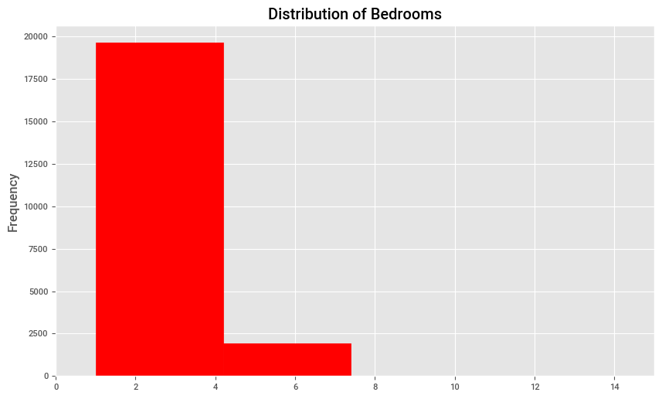
Distribution of Bedrooms

Slide 5
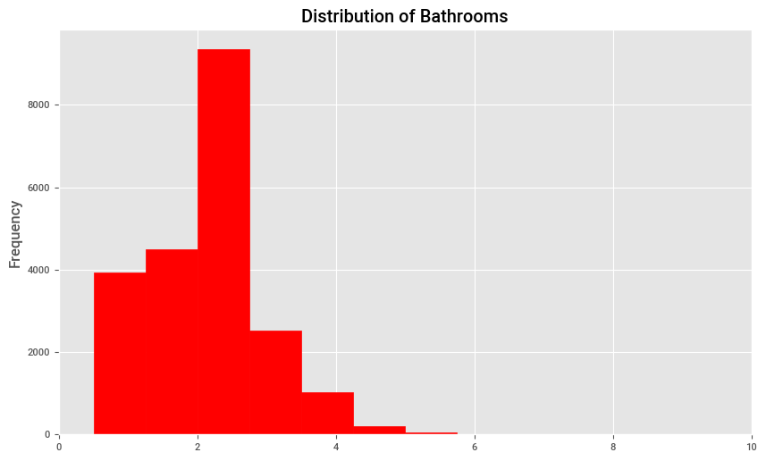
Distribution of Bathrooms

Slide 6
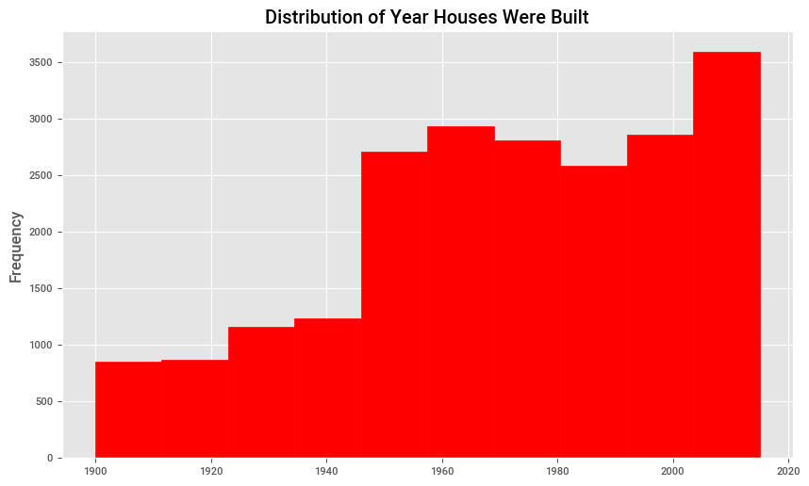
Distribution of year houses were built

Slide 7
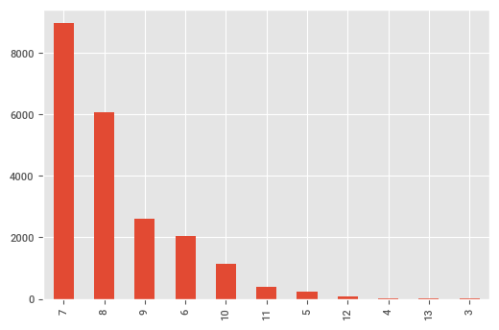
House Grades

Slide 8
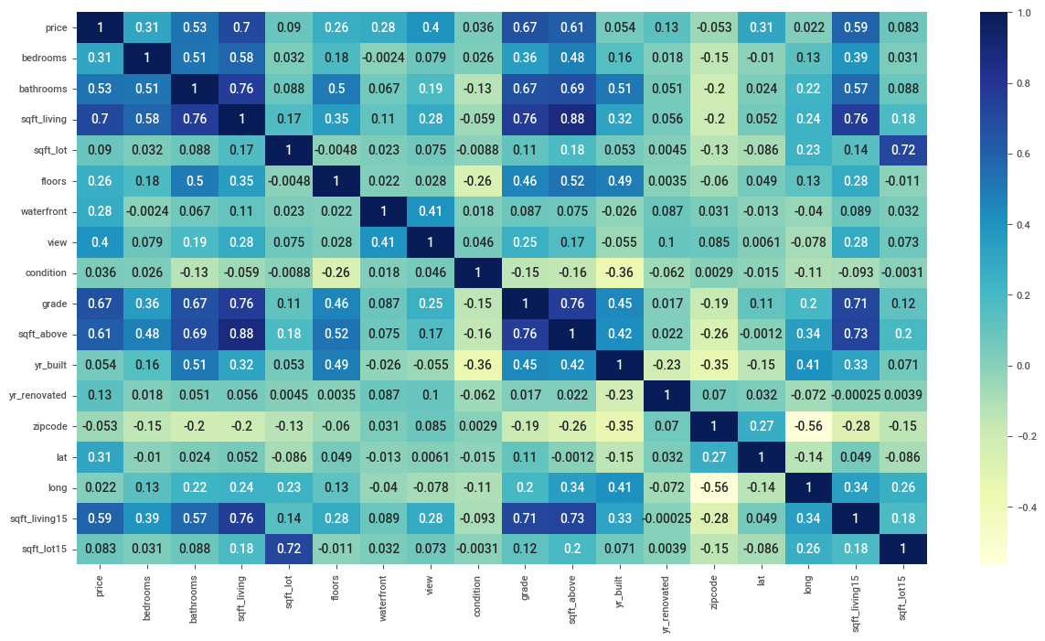
Heatmap to show Correlation

Slide 9
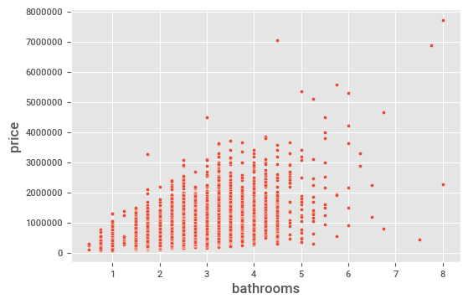
Scatter plot btw Price and No of Bathrooms

Slide 10
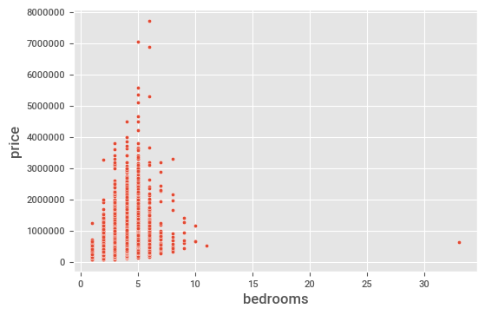
Scatter plot btw Price and No of Bedrooms

Slide 11
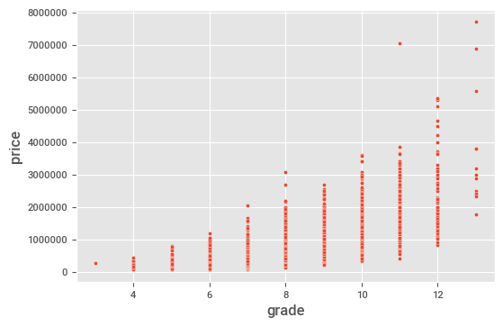
Scatter plot between price and grade

Slide 12
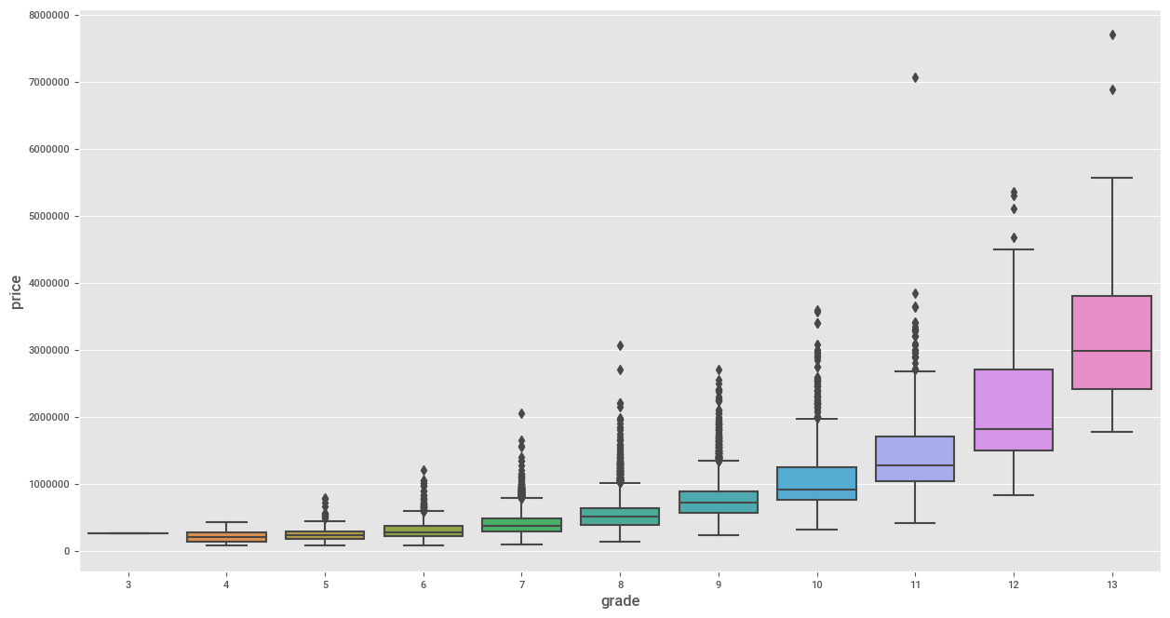
Boxplot between grade and price

Slide 13
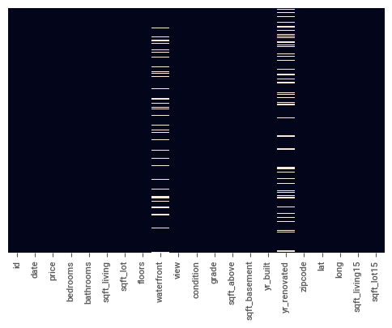
Heatmap with missing values

Slide 14
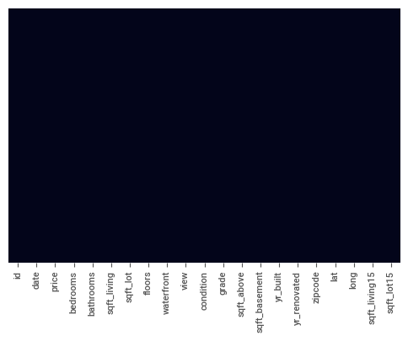
Heatmap without missing values

Slide 15
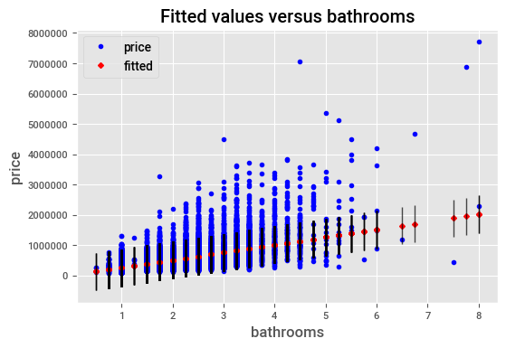
Fitted values versus bathrooms

Slide 16
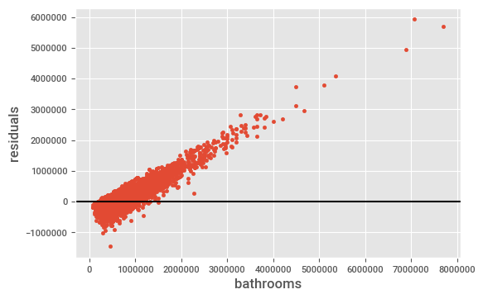
Residuals vs Bathrooms

Slide 18
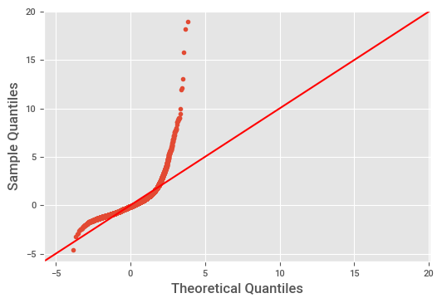

Slide 19
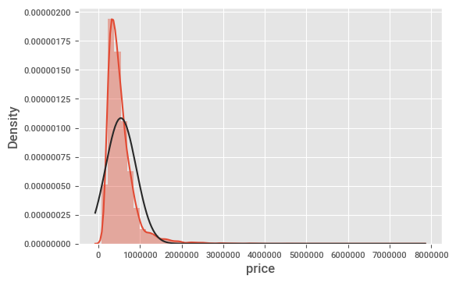
Density vs Price

Slide 20
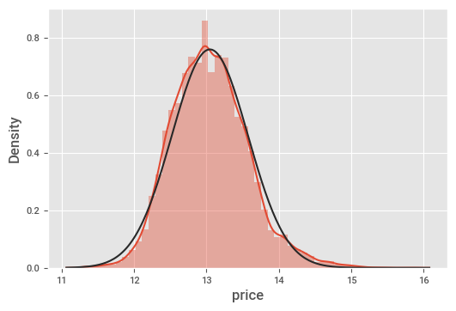
After normalisation

Slide 21
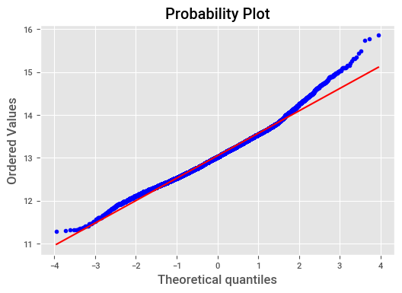
Probability plot after normalisation

Slide 22
Recommendation
I recommend building average houses since it is what majority can afford hence a bigger market
I also recommend last model because it has a higher r squared value of 0.684, which means it has a 68% model accuracy.

